Slide 1
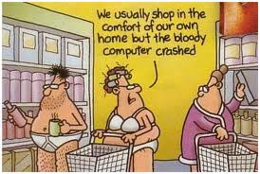
OBJECT-ORIENTED APPLICATION Virtual Shop

Slide 2

PROJECT
Surprised with amazing names of teams
Find out team members
Brainstorming
Best idea
“TFS” – ране of the team
Coding
Implementation
Public demonstration

Slide 3



Team Rapunzel Members
galingeorgiev (Галин Георгиев) Developer
dkalinkov93 (Dimitar Kalinkov) - Developer
Diana_Gospodinova (Diana Gospodinova) - Coordinator
* distanev (Димитър Станев) – Assigned in project without commits
* yordanmm (Йордан Михайлов) - Not assigned in project

Slide 4



From Best Idea to Real project Virtual Shop
Customers
Individual
Corporate
Categories
Food
Drink
Home
Garden
ACTIONS

Slide 5

ACTIONS
Register customer
Shopping
Taxing
E - invoice
E – mail notification
* Some of actions are not implemented yet

Slide 6


